Slide 1


Inventory of Standing Dead Trees in Rhode Island Using Remote Sensing and GIS
Liubov Dumarevskaya
Jason Parent

Slide 2
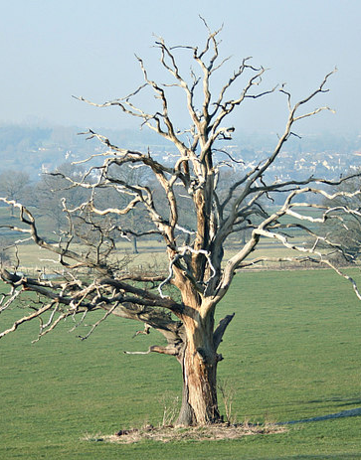
Problem statement
Dead trees pose risks to the human health and infrastructure.
Mapping dead trees help forest managers to perform up-to-date forest care.
Informed management decisions are vital for forest health and safety.
2
Notes:
In Southern New England high forest cover combined with a high population density is resulting in a dangerous situation when standing dead trees create a hazard for a human safety and infrastructure.

Slide 3
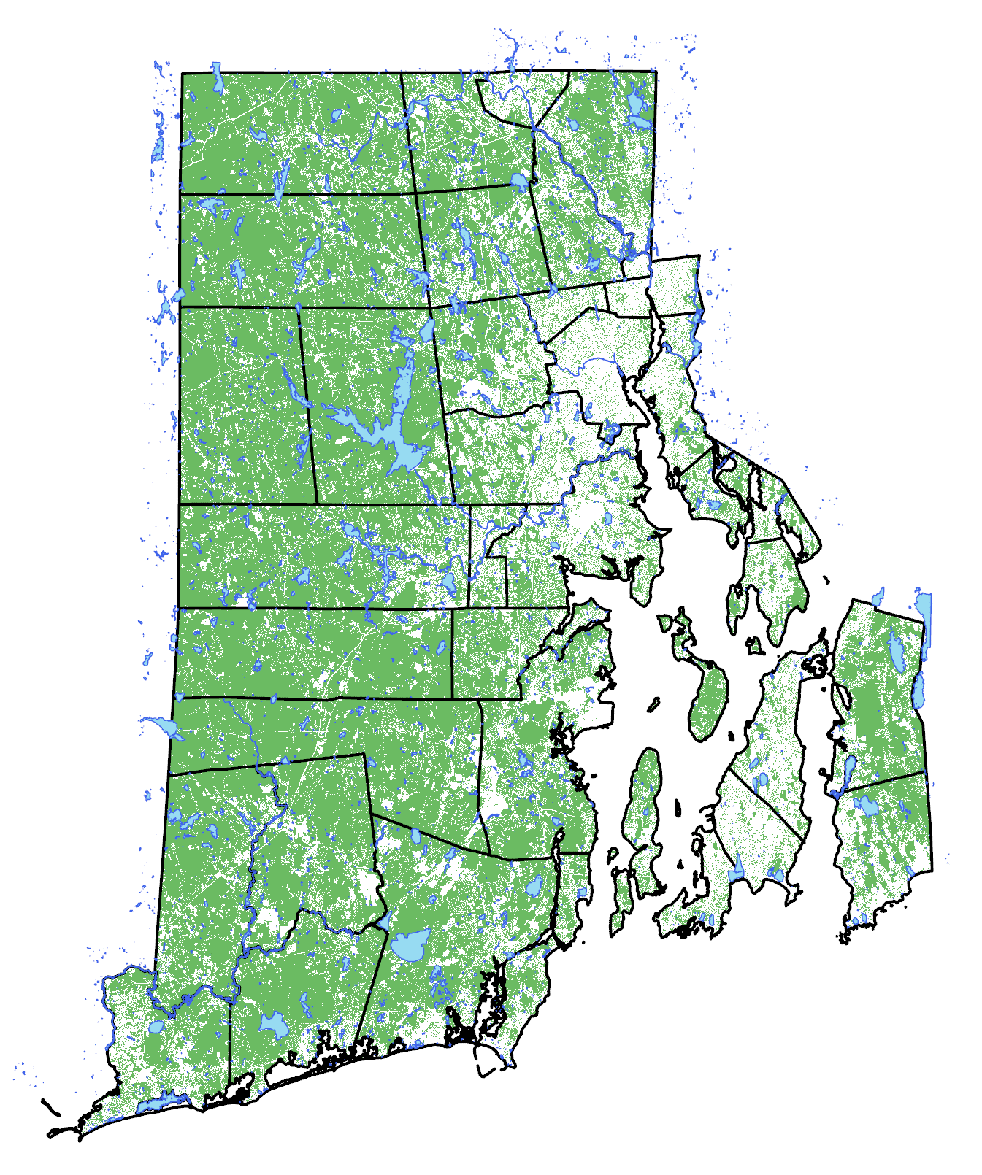



Study Area: Rhode Island
Rhode Island are temperate deciduous and dominated by oak-hickory forests.
Other common species: Hemlock, Beech, Sugar Maple, White Pine.
Several pests' outbreaks: Spongy (a.k.a. Gypsy) moth outbreak, Emerald ash borer, Beech leaf disease.
Forests in Rhode Island
3

Slide 4
Method for automatic image clustering:
ISODATA (Iterative Self-Organizing Data Analysis Technique) is unsupervised classification algorithm.
Groups clusters based on the spectral similarities.
Advantages: quick, does not require training data.
4

Slide 5
Limitations:
Spectral signatures of dead and alive trees are partially overlapping.
Misdetection of non-forest objects (bare ground, roads).
Performance depends on imagery resolution.
Non-forest bright objects can be false positives.
Severe shadows may reduce accuracy.
5

Slide 6
Solutions:
Threshold-Based Mask: Blue band values are different for alive and dead trees.
Threshold-Based Mask: Set threshold values in the blue bands to distinguish non dead tree objects
Threshold-Based Mask: Chosen threshold preformed well across RI but might need to be readjusted.
Forest mask: Used to exclude falsely detected non-forest objects such as buildings, bare ground, cars etc.
Forest mask: Derived from CCAP landcover dataset
6
Notes:
Range of blue band set to >150

Slide 7
Data Requirements for Toolbox:
RGB high‑resolution aerial imagery in leaf-on period.
Optional forest mask for improved accuracy.
ArcGIS Pro with Spatial Analyst Extension.
Data used:
True-color (RGB) aerial image with 15 cm. resolution, collected in July 2019.
1 m resolution 2016 land cover dataset from NOAA Coastal Change Analysis Program (CCAP).

Slide 8
Workflow step-by-step:
1. Optional forest masking
2. IsoCluster spectral clustering
3. Maximum Likelihood classification
4. Dead-class extraction
5. Blue-band reflectance threshold
6. Morphological smoothing
7. Raster → polygon conversion
8. Area / dissolve / buffer filtering
9. Final output polygons

Slide 9
Smoothing & Noise Reduction:
• Majority Filter – removes isolated pixels
• Expand – closes small gaps
• Shrink – restores crown shape
• RegionGroup – prepares polygons
• Area-based filtering – removes noise

Slide 10
Parameter Selection:
• IsoCluster classes: 10 default
• Minimum tree area: 1–4 m² depending on resolution
• Blue band index: choose blue band index in imagery
• Minimum buffer area: 20–80 m² depends on image size
• Parallel processing: enabled for faster processing

Slide 11
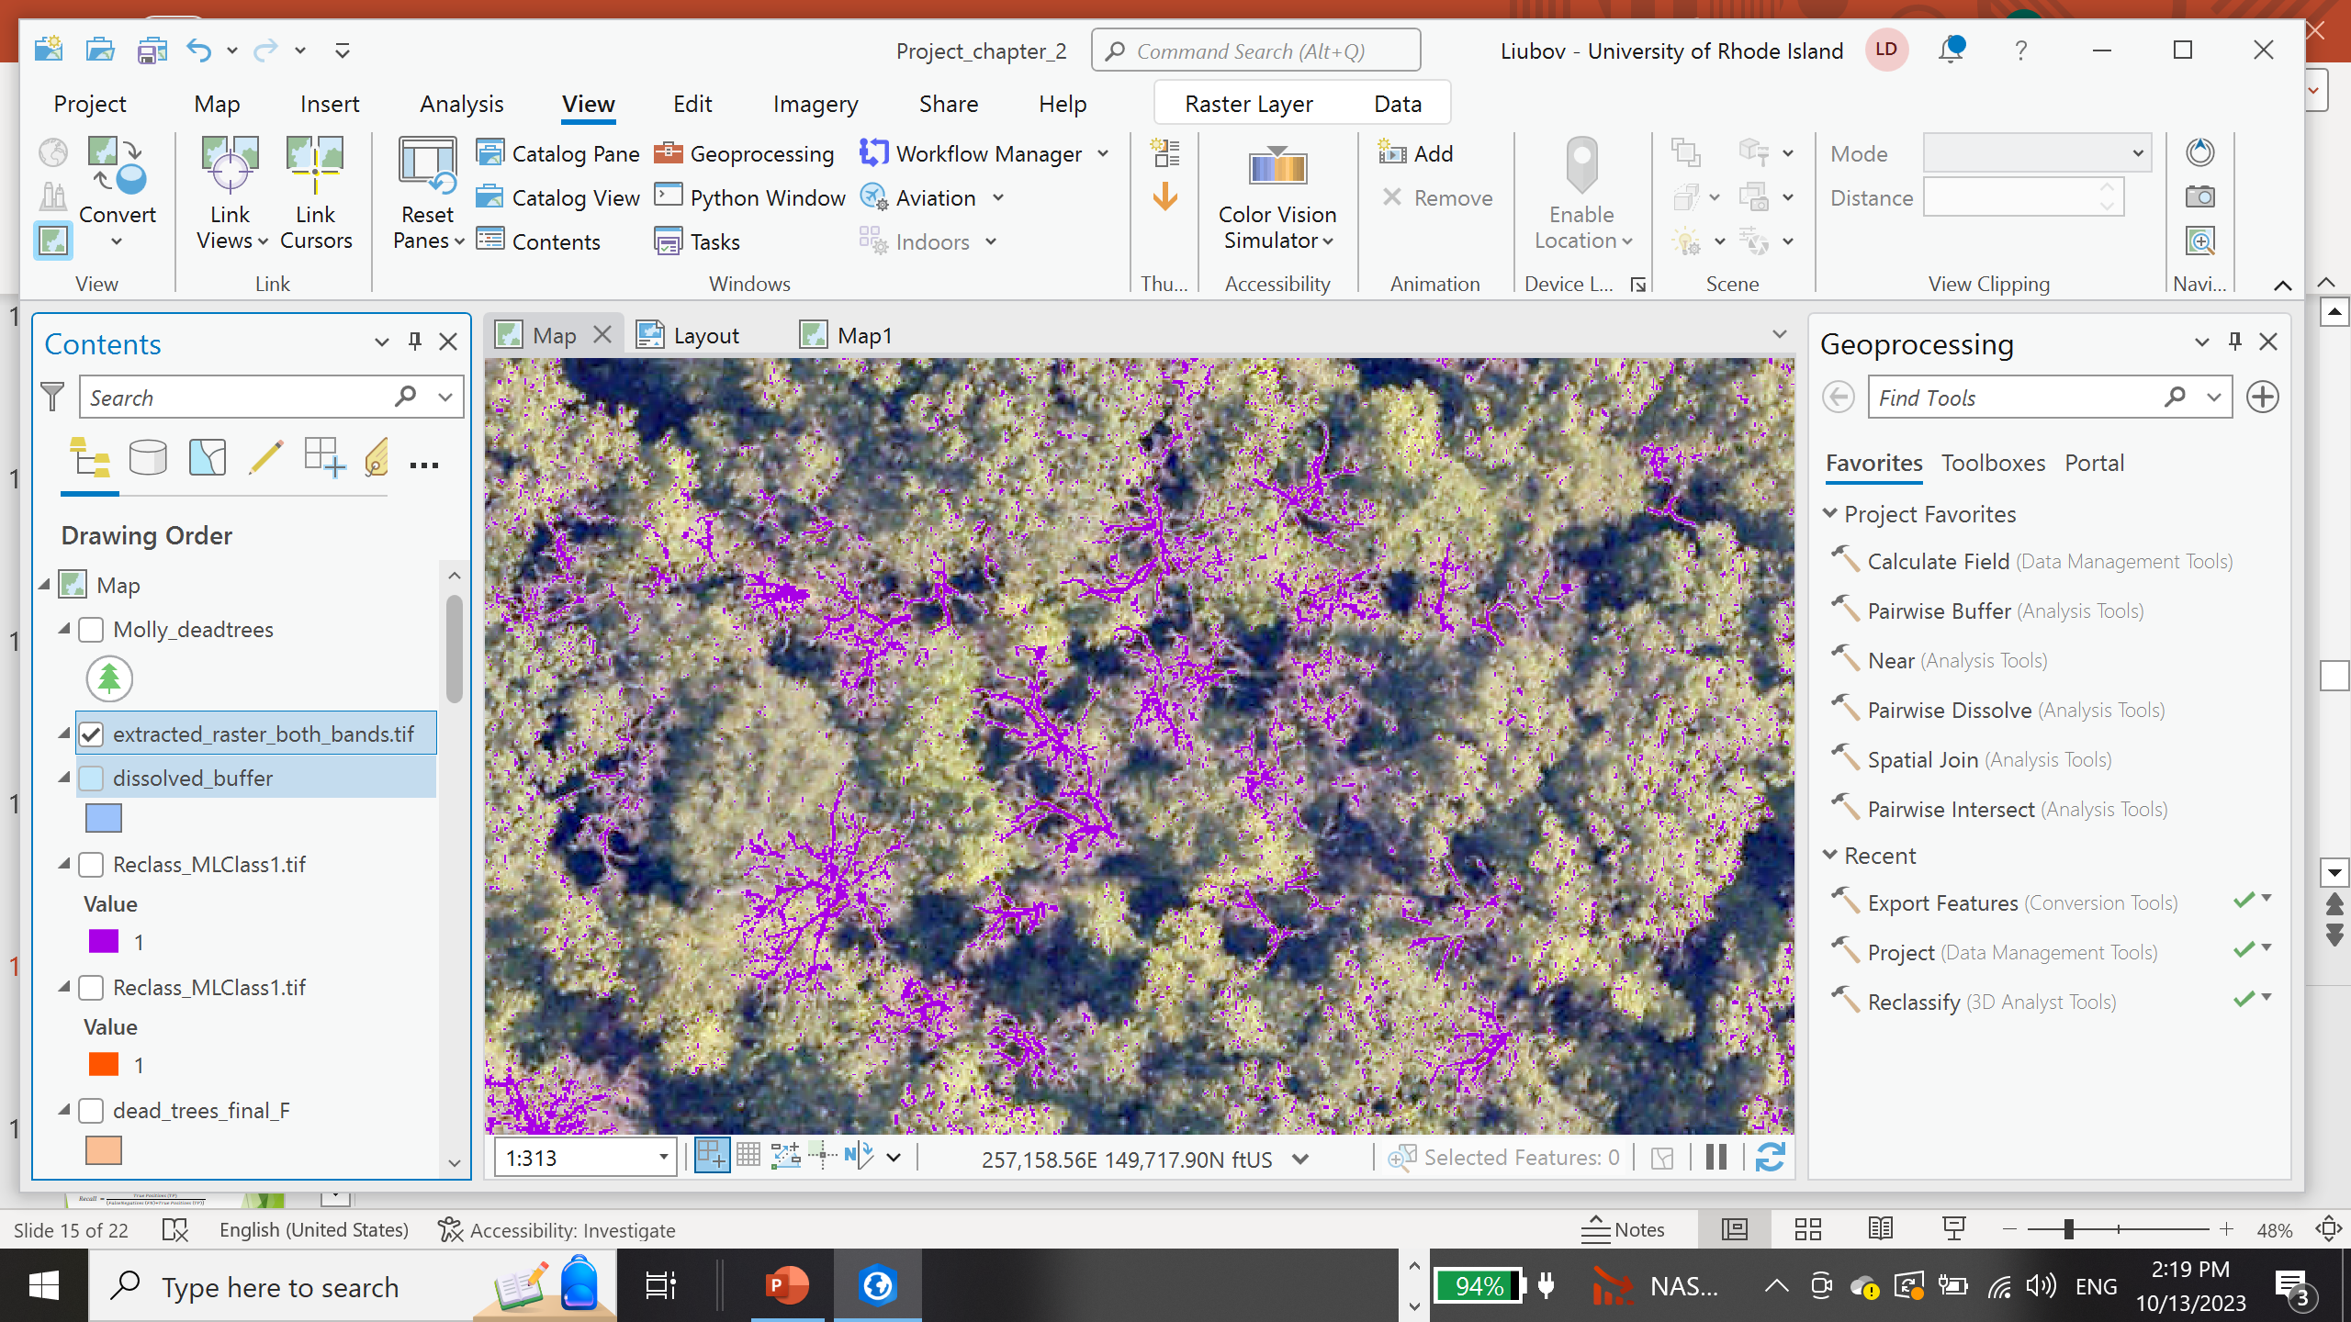
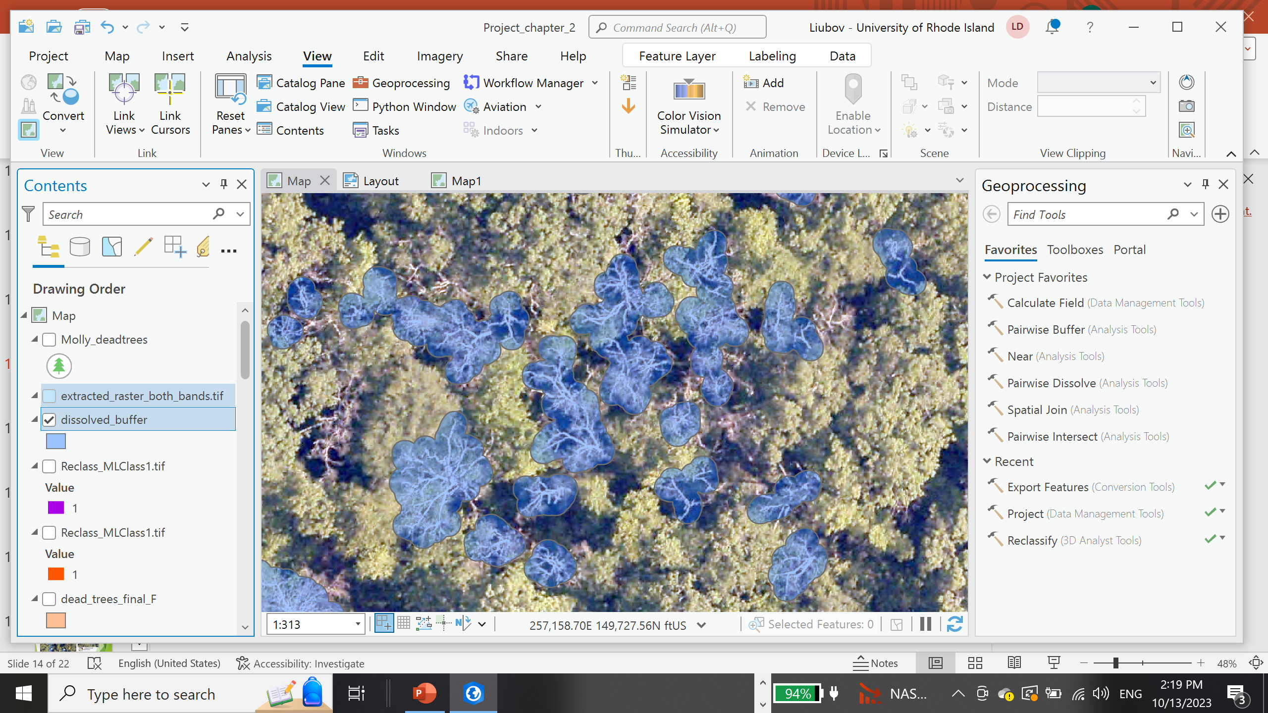
Polygon refinement
Polygons buffered to aggregate small disconnected pieces of a whole tree to create an exact shape of a tree.
11
Notes:
We are also excluding polygons too small in the area to exclude noise not filtered by previous operations.

Slide 12
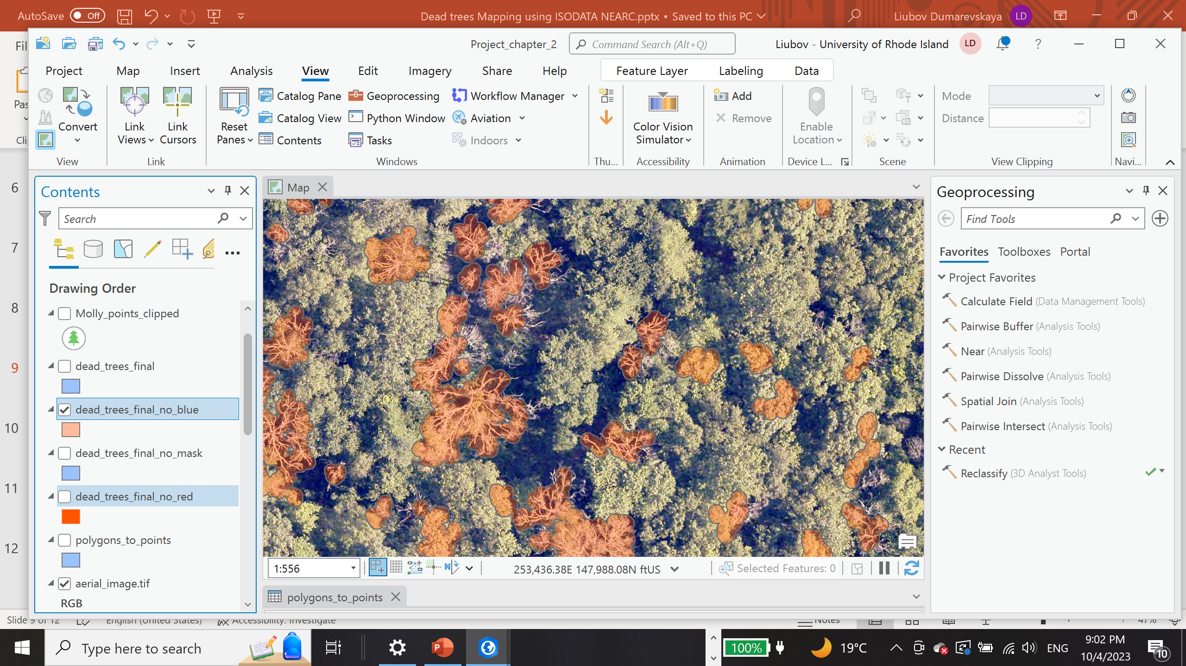
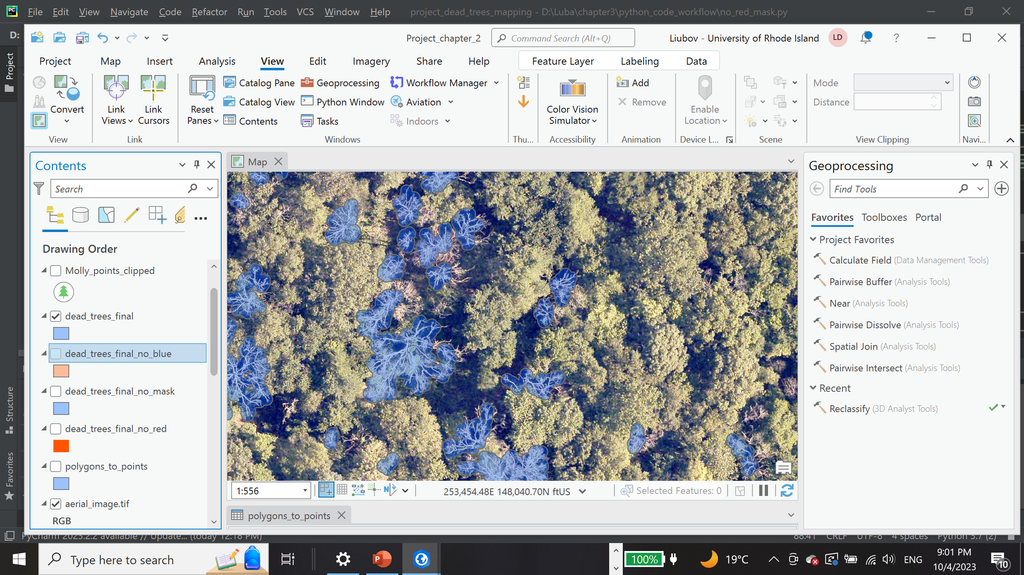
Dead trees detection with and without threshold for pixel-based ISODATA
This method reduce false positives by 35 %
Before threshold application
After threshold application
12
Notes:
This method reduce false positives by 35 %

Slide 13
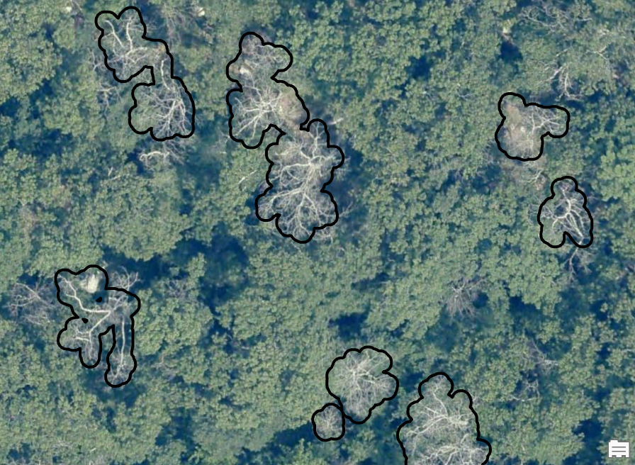
Example of output:

Slide 14
Toolbox Strengths:
• Fully automated, reproducible workflow
• Handles large imagery datasets
• Detects individual snags and multi-tree clusters
• No training samples required
• Works with any RGB imagery in ArcGIS Pro

Slide 15
Applications & Use Cases:
• State forest health monitoring
• Utility vegetation management
• Storm-damage assessments
• Wildfire risk modeling
• Urban canopy monitoring

Slide 16
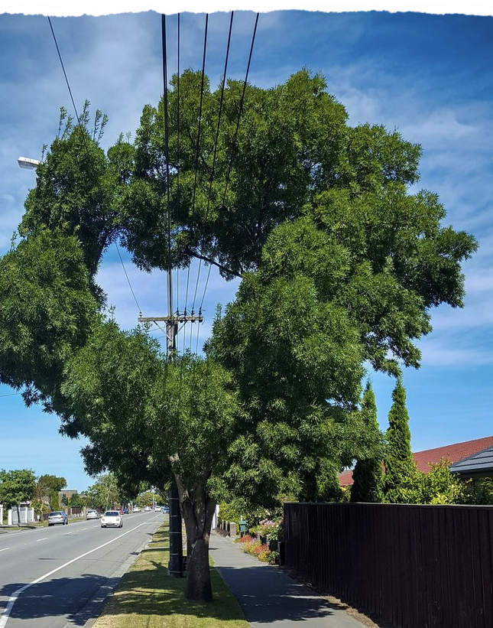
Questions or comments?
Thank you for your attention!

